Slide 1










Open modification search (OMS)
+1000 known modifications/artifacts
Amino acid substitutions
Semi-tryptic peptides
Modifications only observed in MS1
AI predicted LC-MS/MS peptide behaviour for accurate PSM matching.
Substantial increase in peptide identifications over OMS by considering highly likely co-eluting matches.
Can be tailored to specific experimental conditions (e.g. TMT).
Highly competitive with state-of-the-art OMS engines.
Is available in the cloud!
ionbot.cloud
Degroeve S. et al, bioRxiv, https://doi.org/10.1101/2021.07.02.450686

Slide 2
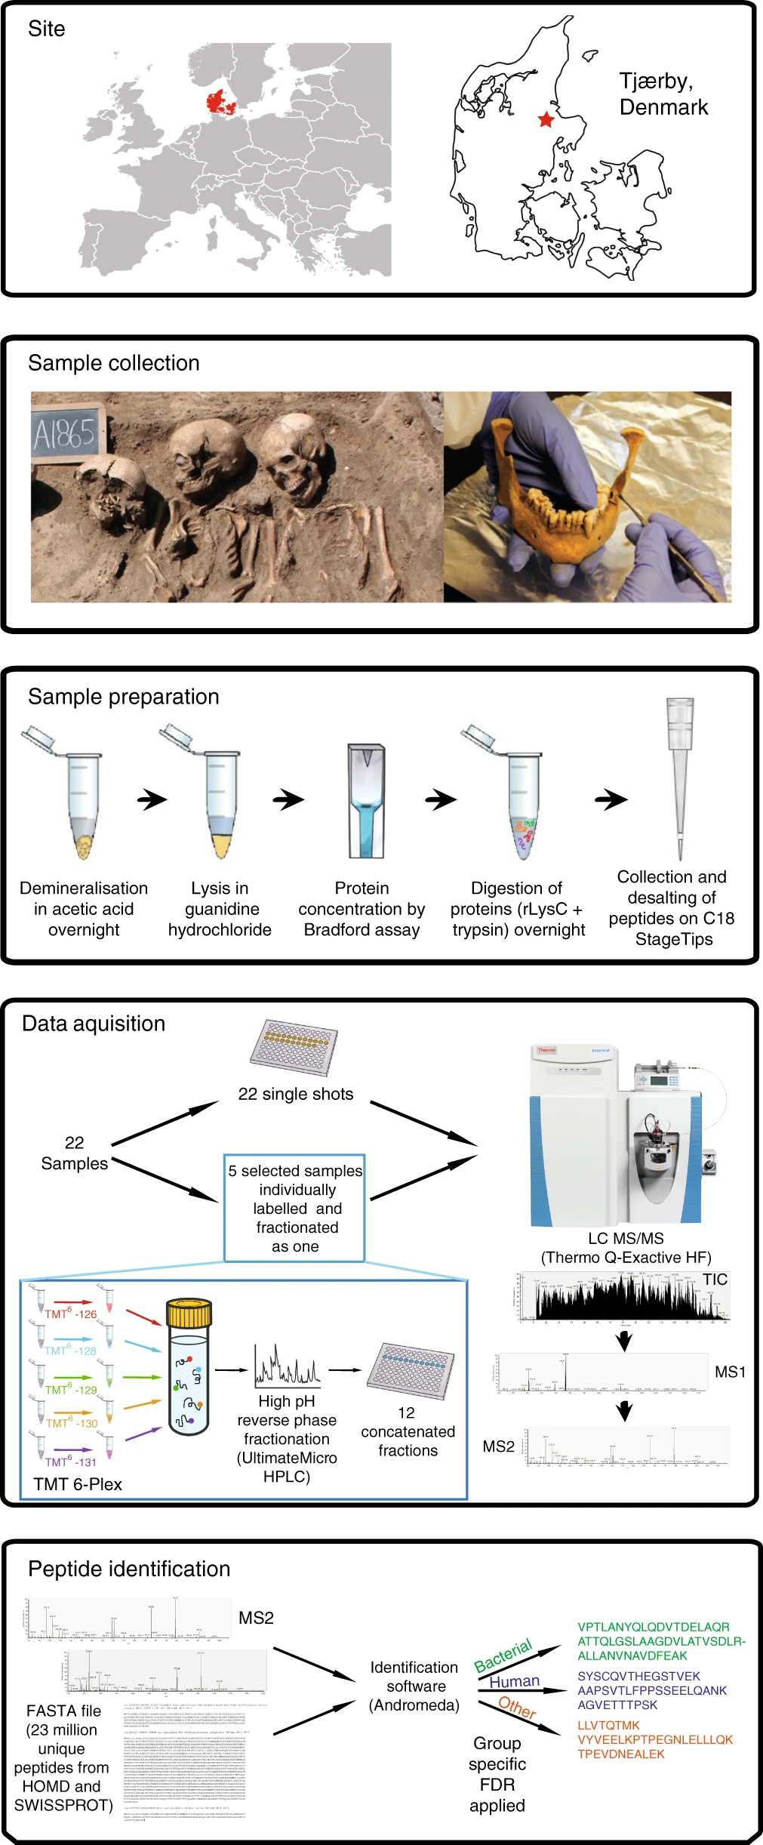
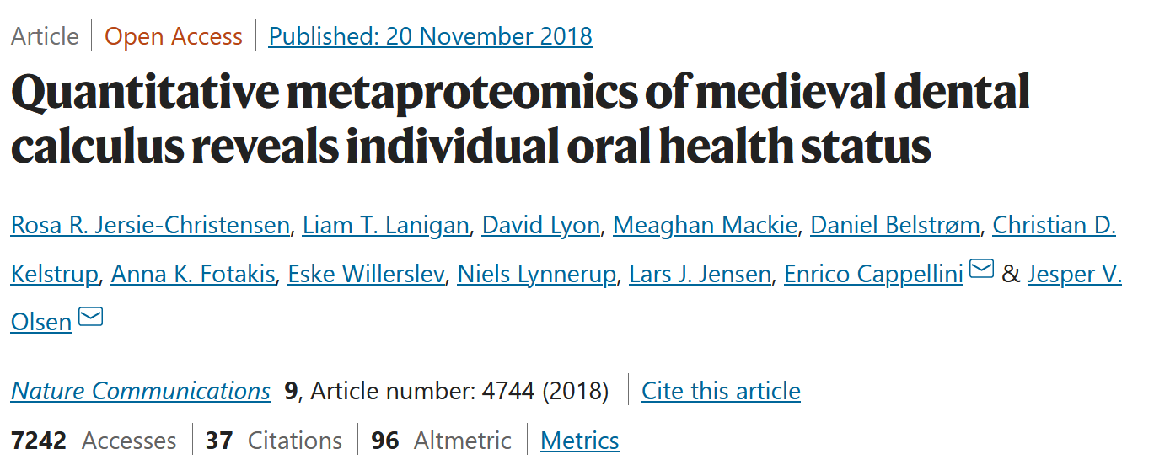

Slide 4


Slide 5
Procedure:
ionbot OMS with Carbamidomethyl(C) as fixed and Oxidation(M) as variable
Filter target database for identified proteins
ionbot OMS with
Carbamidomethyl(C)
Oxidation(M)
Oxidation(P)
Deamidated(N)
Deamidated(Q)
Glu->pyro-Glu+Methyl:2H(2)13C(1)(E)
Acetyl(N-term)
Methyl(D)
Methyl(E)
(OMS = max 2 variable + 1 unexpected modification)

Slide 6
Today you will learn the basics of interpreting ionbot results using jupyter notebooks
Using the ionbot.cloud
Tableau visual result analysis
Binder (jupyter notebook) result analysis
Reading ionbot output data
PSM result inspection (higher and lower ranked PSMs)
Universal spectrum identifier (USI) and Lorikeet
Protein results
(Modification analysis and modification profile clustering)

Slide 7
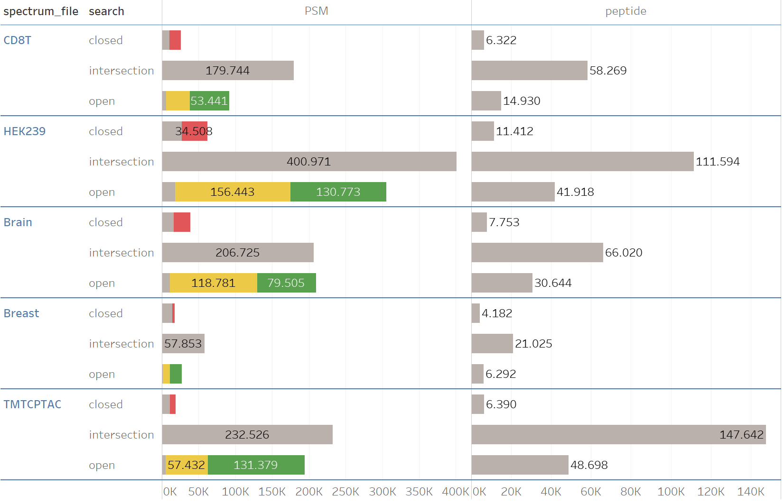

Slide 8



github.com/RobbinBouwmeester/ionbot.workshop
Contact:
sven.degroeve@ugent.be (general)
Lennart.martens@ugent.be (general)
kevin.velghe@ugent.be (tech issues)
ralf.gabriels@ugent.be (feature reqs)
robbin.bouwmeester@ugent.be (feature reqs)
enrico.massignani@ugent.be (running ionbot)
mybinder.org
anaconda.com/products/distribution

Slide 9
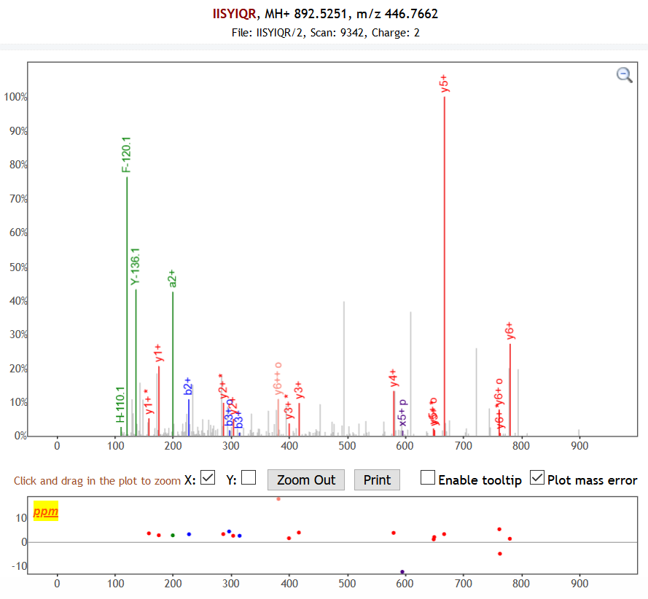
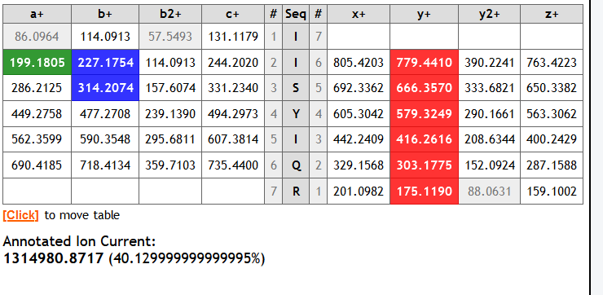

Slide 10
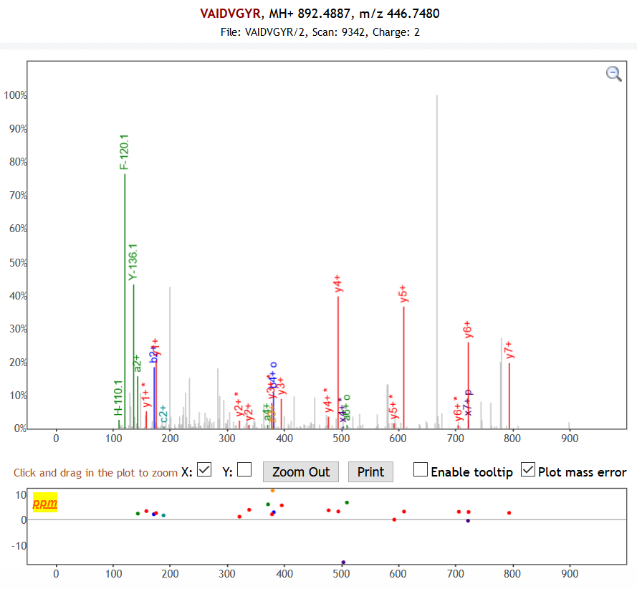
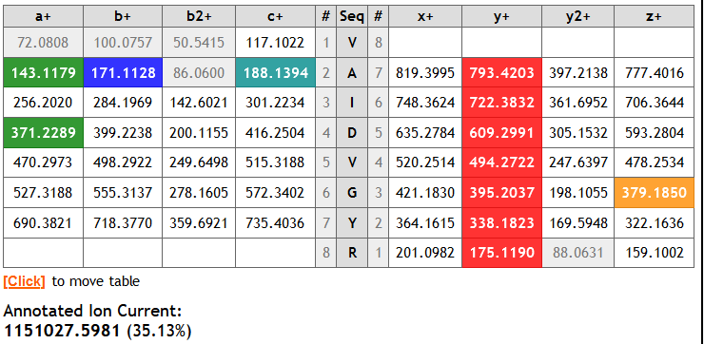

Slide 11
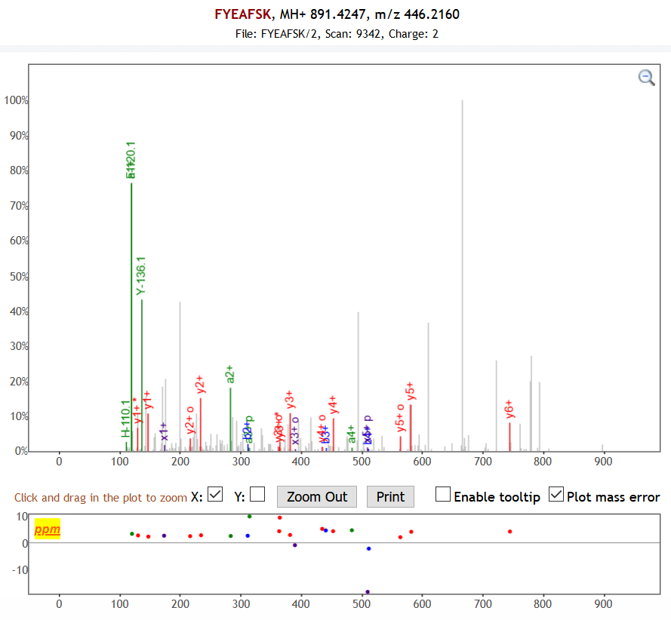
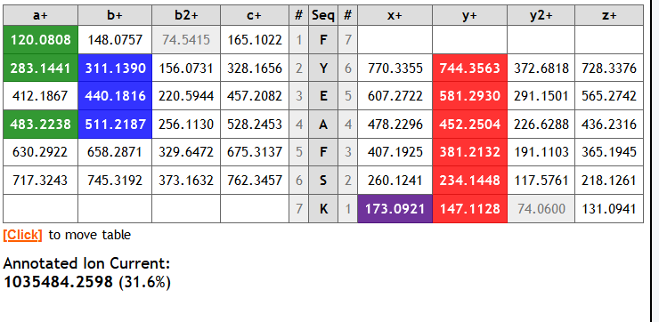

Slide 12
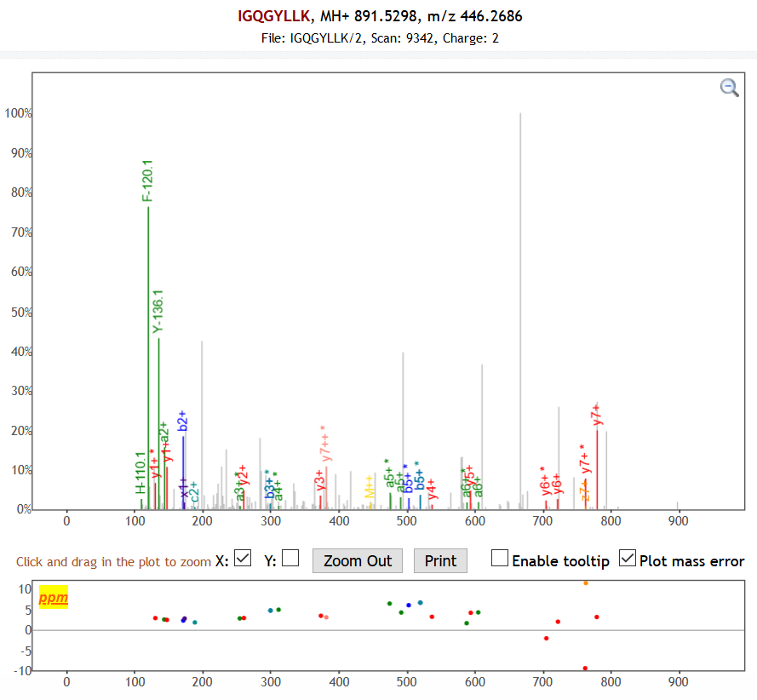
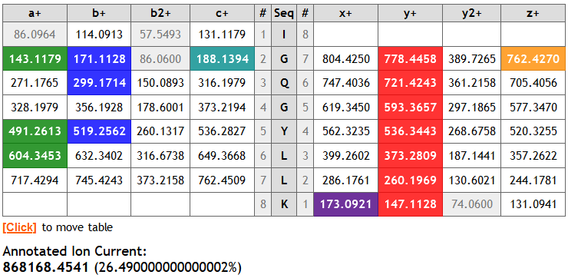

Slide 13
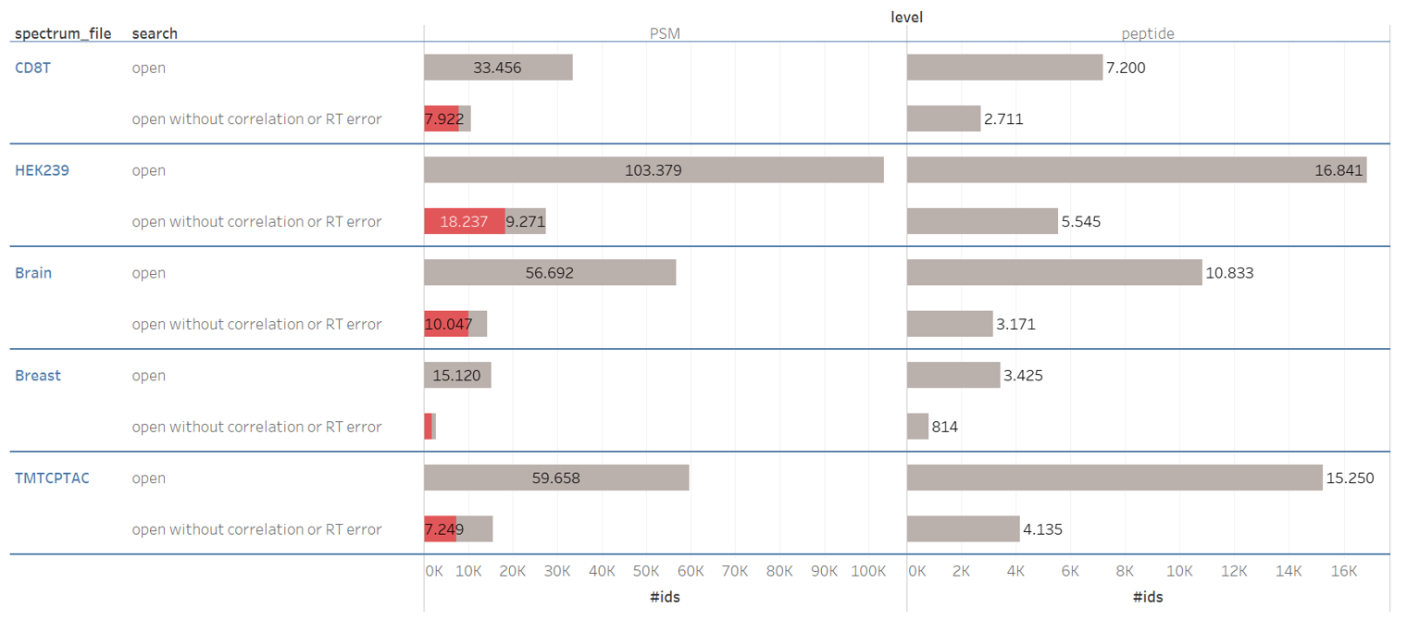

Slide 14
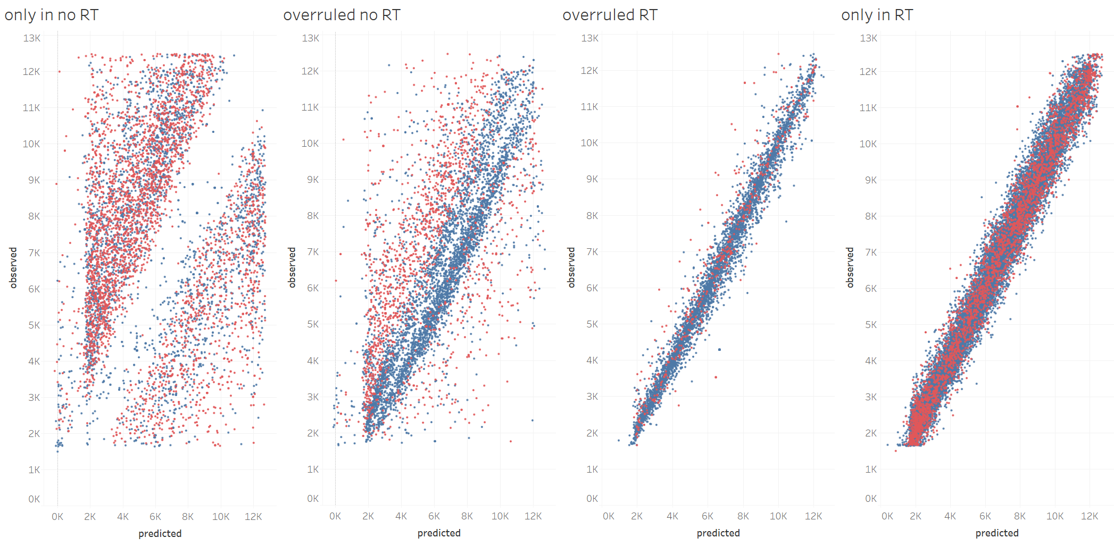

Slide 15
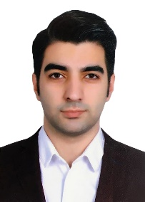



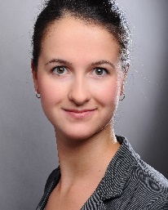

















www.compomics.com
@compomics

